Slide 1
Inverted Index
Dictionary | Postings
Brutus | 1 | 2 | 4 | 11 | 31 | 45 | 173 | 174
Caesar | 1 | 2 | 4 | 5 | 6 | 16 | 57 | 132
Calpurnia | 2 | 31 | 54 | 101

Slide 2
Inverted Index
Terminology Note: The dictionary is also called “vocabulary” or “lexicon”. Each item in the list of the documents in which the word occurs is called “posting”. The list is called “postings list” (or “inverted list”).
Indexing and Inverted Index
Formally, indexing is the process of associating one or more keywords with each document they are about. The vocabulary used can either be controlled or uncontrolled (closed or open.)
Index :doc_{i}→kw_{j}
The inverse mapping captures, for each keyword, the documents it describes:
Index⁻¹ :kw_{i}→doc_{j}
Keywords are linguistic atoms – typically words, pieces of words, or phrases – used to characterize the content of a document. They must bridge the gap between the users’characterization of information need (i.e. their queries) and the characterization of the documents’topical focus against which these will be matched.

Slide 3
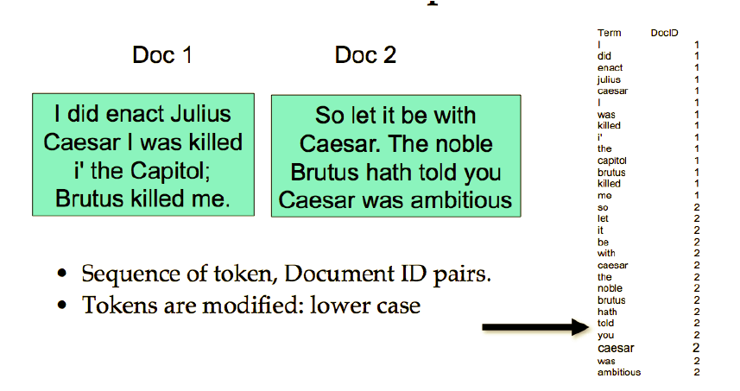
Inverted Index Example

Slide 4
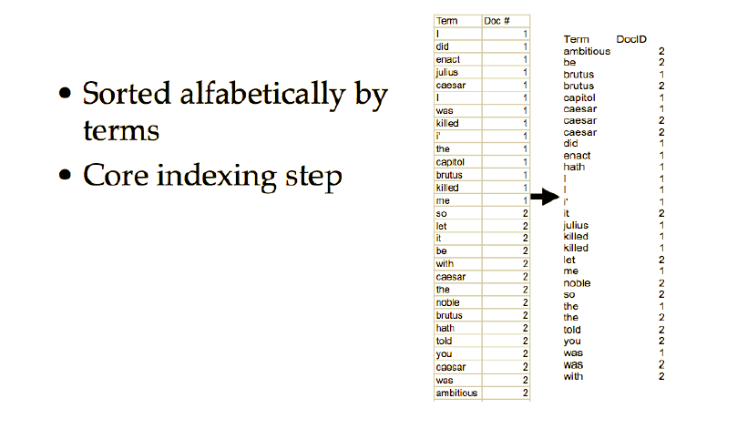
Inverted Index Example

Slide 5
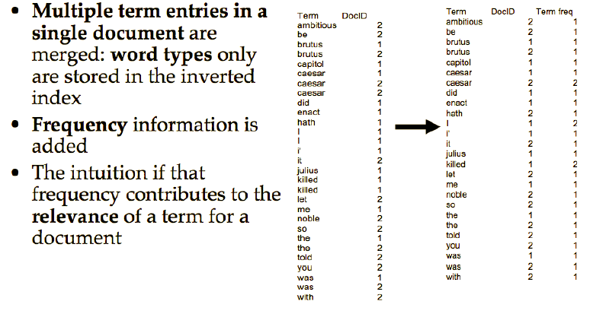
Inverted Index Example

Slide 6
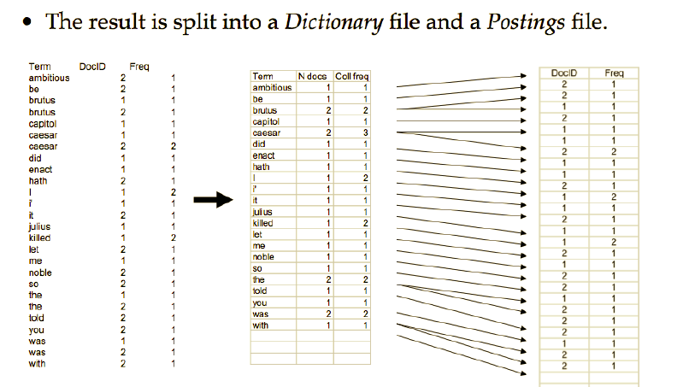
Inverted Index Example

Slide 7
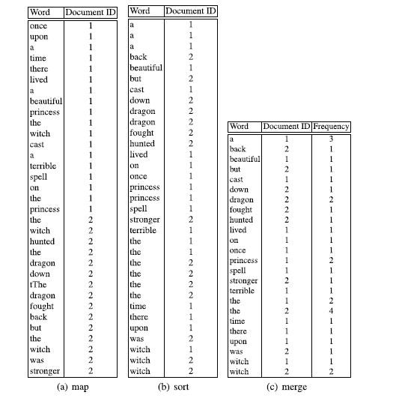
Inverted Index Example

Slide 8
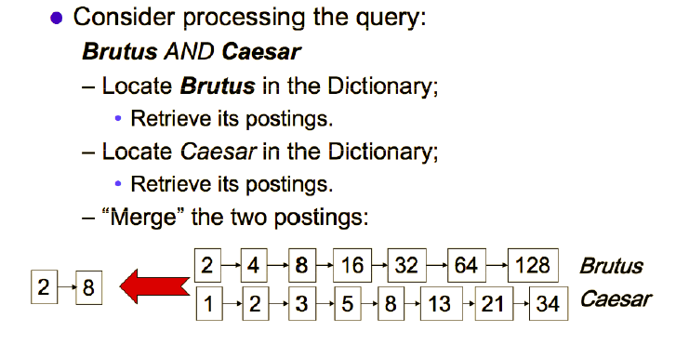
Inverted Index Example

Slide 9
Index and inverted index: Exercise
Consider these documents
Doc1: break through drug for schizophrenia
Doc2: new schizophrenia drug
Doc3: new approach for treatment of schizophrenia
Doc4 : new hopes for schizophrenia patients
(a) Draw the term-document matrix for this document collection.
(b) Draw the inverted index representation of this collection.
(c) what are the returned results for the query: schizophrenia AND drug;

